Slide 1

FRONTAL EEG BASED EMOTION RECOGNITION USING A 3-ELECTRODE SYSTEM
Presented by,
GROUP 4 :
Anusree Pradeep
Archana Radh J
Arunima Sudheer
Sandhya M
GUIDED BY :
Prof. Anu Assis

Slide 2
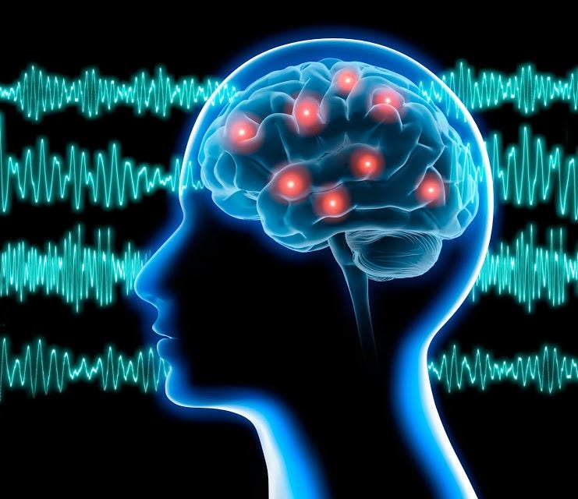
CONTENTS
An Introduction
Aim & Objective
Literature Review
Methodologies
Progress Update
Results
Cost Analysis
Conclusion
Future Scope
Reference

Slide 3
AN INTRODUCTION
The brain is the most advanced part of the nervous system and possesses immensely powerful functions and complex structures. Electroencephalogram (EEG) is a significant bioelectric signal produced by neural activity that reflects the physiological processes of neurons in the brain and contains a wealth of brain activity information.
Emotion is at the core of human consciousness, shaping our thoughts, decisions, and interactions. It not only drives our behavior but also manifests as a dynamic interplay between inner experiences and outward physiological expressions.

Slide 4
PROBLEM STATEMENT :
Emotion recognition is crucial for mental health monitoring, human-computer interaction, neurofeedback, and affective computing.
Traditional EEG systems, however, are expensive, bulky, and require complex setups with numerous electrodes, limiting their accessibility and practicality for everyday use.
SOLUTION :
A 3-electrode system provides a compact, cost-effective, and user-friendly alternative while maintaining reliable performance along with a BioAmp EXG Pill, a compact biopotential sensor, and Arduino Uno provides an affordable and efficient solution for recording EEG signals and Emotion recognition.

Slide 5

AIM & OBJECTIVE

Slide 6
AIM :
To develop a portable, real-time EEG-based emotion recognition system with a 3-electrode setup using the BioAmp EXG Pill, ensuring low cost, ease of use, and accurate classification of emotions.
OBJECTIVES :
To design and implement an EEG acquisition system using single channel three electrodes system.
To integrate the BioAmp EXG Pill with an Arduino UNO R3 for signal acquisition and use of software for real-time signal visualization and emotion detection.
To validate the system's accuracy in detecting emotions specifically stress and relaxation.

Slide 7
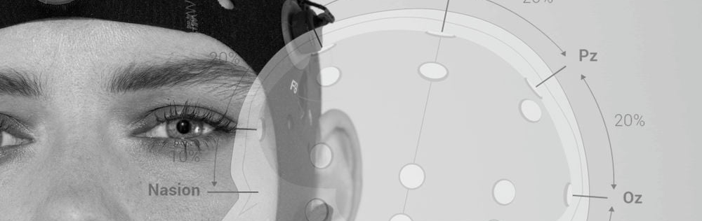
Literature review

Slide 8
No. | Author(s) | Year | Publication Source | Conclusion/Takeaway
1 | Jalilifard, A., Brigante Pizzolato, E., Kafiul Islam, M. | 2016 | IEEE Engineering in Medicine and Biology Conference | Demonstrated 92–94% accuracy with a single electrode (scalp EEG) using SVM and KNN. Minimal setup for emotion recognition. confirms single-electrode EEG's effectiveness for emotion recognition
2 | Li, J. W., Zeng, X., & Zhao, H. | 2023 | Frontiers in Neuroscience | 92% accuracy using single-channel through brain rhythm code, supporting efficient emotion recognition systems.
3 | Gómez, A., Quintero, L., López, N., Castro, J., Villa, L., Mejía, G. | 2017 | VII Latin American Congress on Biomedical Engineering CLAIB 2016 | Used Stationary Wavelet Transform for emotion classification with a single-channel EEG system. Significant for signal processing in emotion recognition.
4 | Mamee, T., Manorost, P., Chamroon, C., & Thunsiri, K. | 2023 | IEEE Conference on ECG Signal Processing | BioAmp EXG Pill shows superior signal acquisition in comparison to AD8232, offering better performance for EEG-based emotion tasks.
5 | Sandesh, R. S., & Venkatesan, N. | 2015 | Advances in Computing and Communications | Provides insights into designing single-channel bio signal amplifiers, essential for your EEG signal acquisition setup.

Slide 9
No. | Author(s) | Year | Publication Source | Conclusion/Takeaway
6 | Saptono, D., Wahyudi, B., & Irawan, B. | 2016 | MATEC Web of Conferences | Demonstrates a practical setup for EEG signal acquisition using Arduino and EEGAnalyzer, relevant for DIY setups.
7 | Lopez, R. | 2022 | GitHub Repository | Collection of EEG-based projects, offering open-source resources for emotion recognition research. Ideal for project inspiration.
8 | BioAmp EXG Pill (2022) | 2022 | Instructables | Step-by-step guide for implementing frontal EEG using BioAmp EXG Pill. Key for integrating hardware into emotion recognition systems.
9 | Morsalin, S. M. S. | 2020 | Master’s Program of Green Technology for Sustainability, Nanhua University | Offers essential knowledge on front-end circuit design for EEG systems, aligning with your hardware-based approach.
10 | Li, X., Song, D., Zhang, P., & Hou, Y. | 2022 | arXiv | Provides a comprehensive review of EEG-based emotion recognition pipelines, classifiers (SVM, LDA), and electrode regions. Supports classifier integration for emotion tasks.

Slide 10
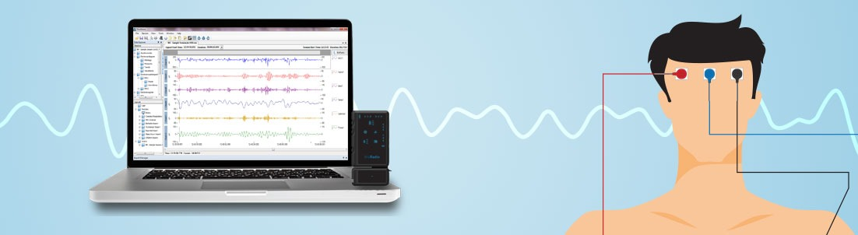
METHODOLOGY & PROGRESS

Slide 11
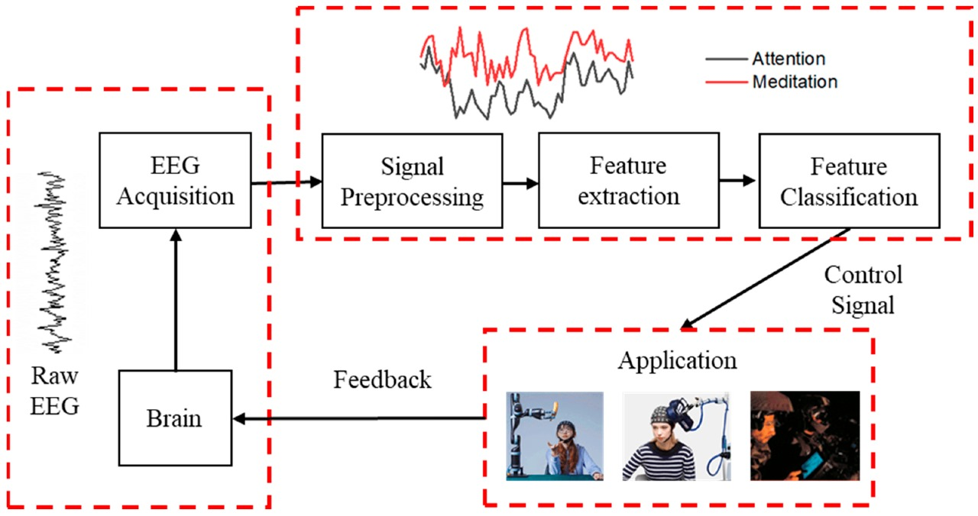
methodology
BLOCK DIAGRAM :

Slide 12
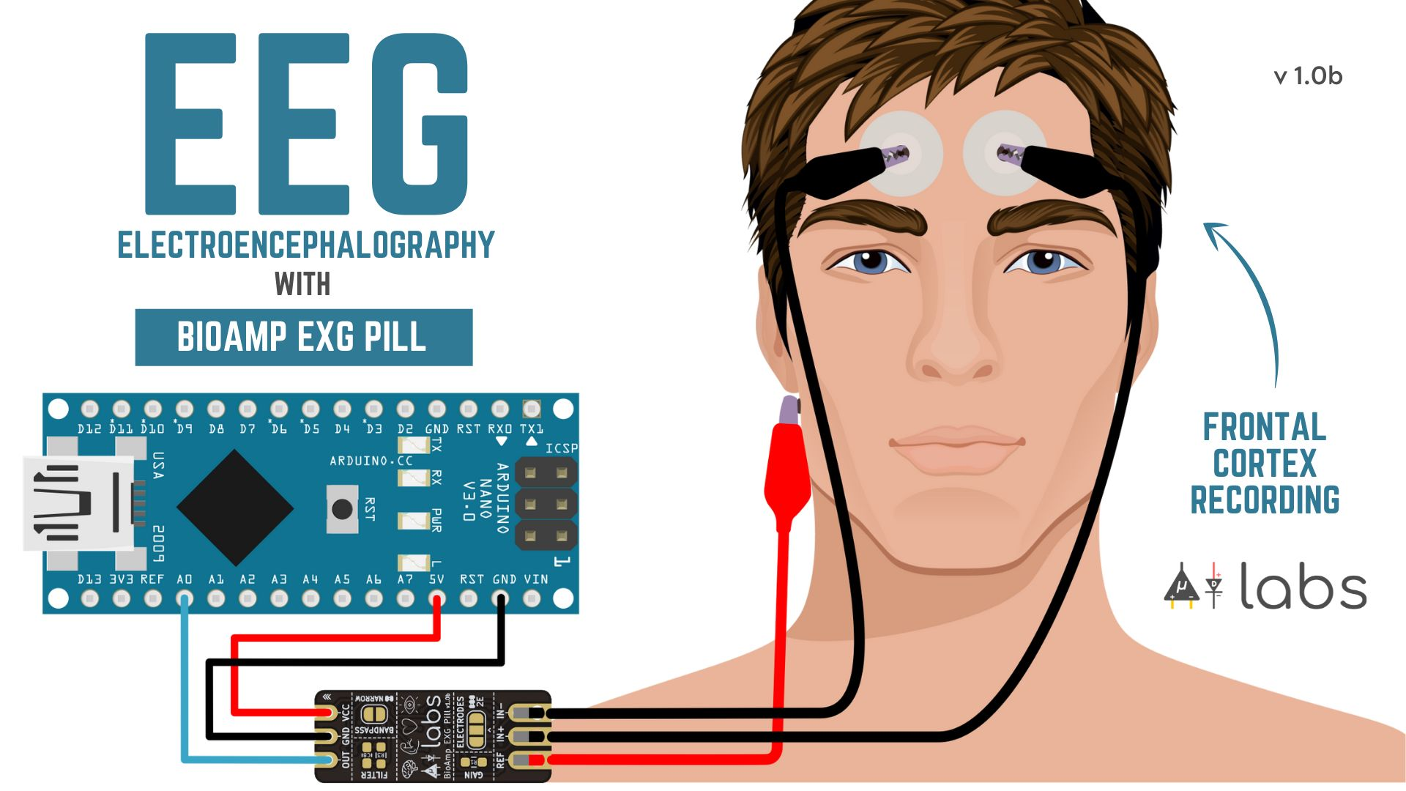
HARDWARE COMPONENTS :
Three electrodes (fp1/fp2, T7/T8 as reference,A1/A2 as ground).
BioAmp EXG Pill (3-electrode EEG).
Arduino UNO (signal acquisition).
Conductive gel will be used to reduce skin-electrode.
SOFTWARE :
Spike Recorder: Capture EEG signals in .wav format
Arduino IDE
Python & Libraries (e.g., NumPy, Pandas, Scipy, joblib, sklearn, cborn, os)

Slide 13
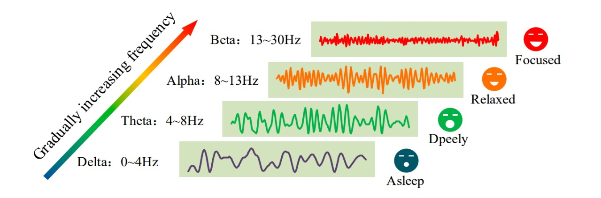
EEG SIGNAL CHARACTERISTICS:
Sleepy

Slide 14
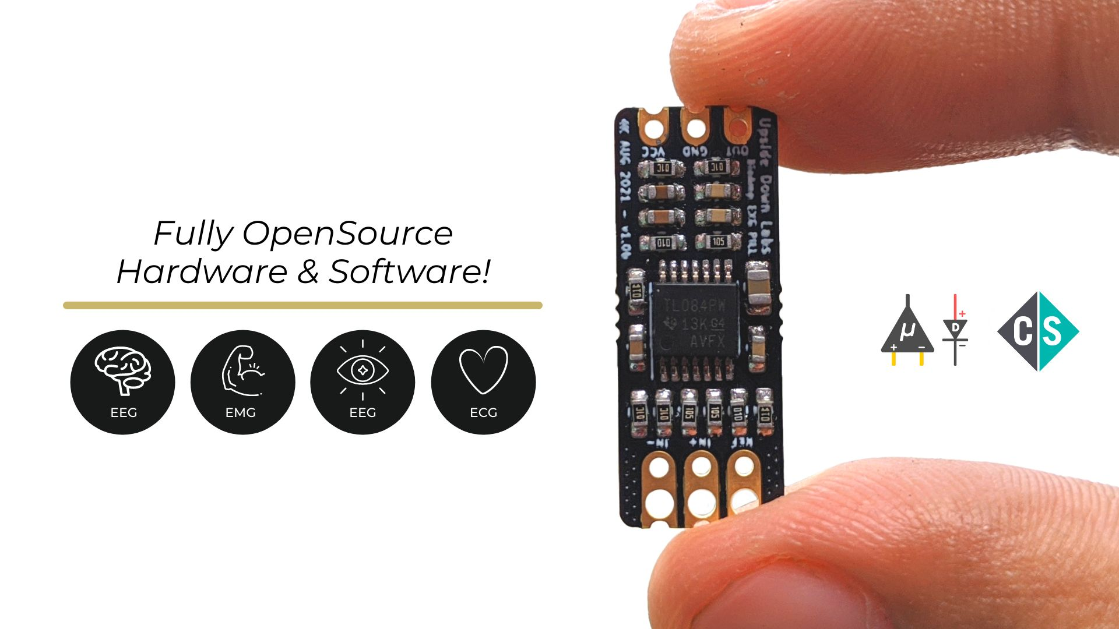
BIOAMP EXG PILL :
Input Voltage: 4.5 - 40 V
Input Impedance: 10¹² Ω
Compatible Hardware: Any ADC input
Biopotentials: ECG, EOG, EMG, and EEG (configurable Band-Pass)
No. of channels: 1
Electrodes: 2 or 3 (configurable)
Wearable: Yes
Dimensions: 25.4 x 10.0 mm
Designed for Use With a Carrier Board: Yes
Open Source: Hardware + Software

Slide 15
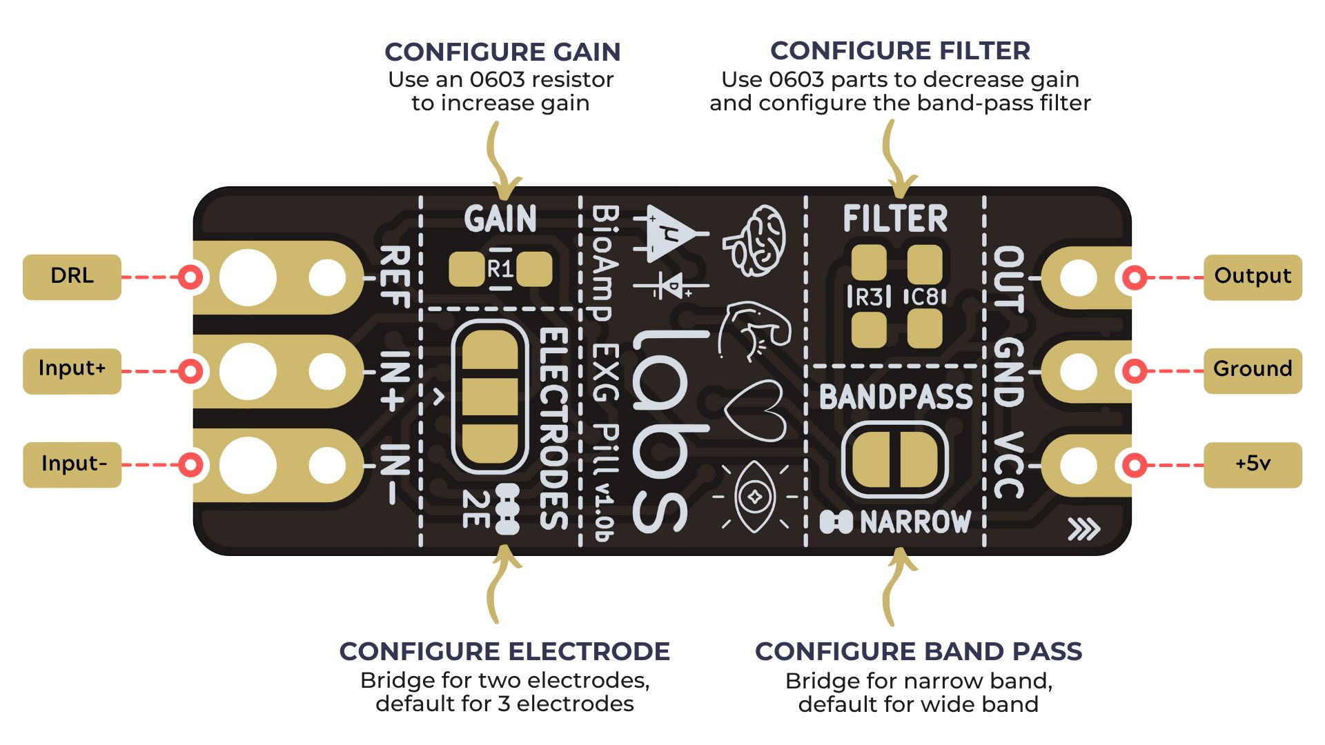
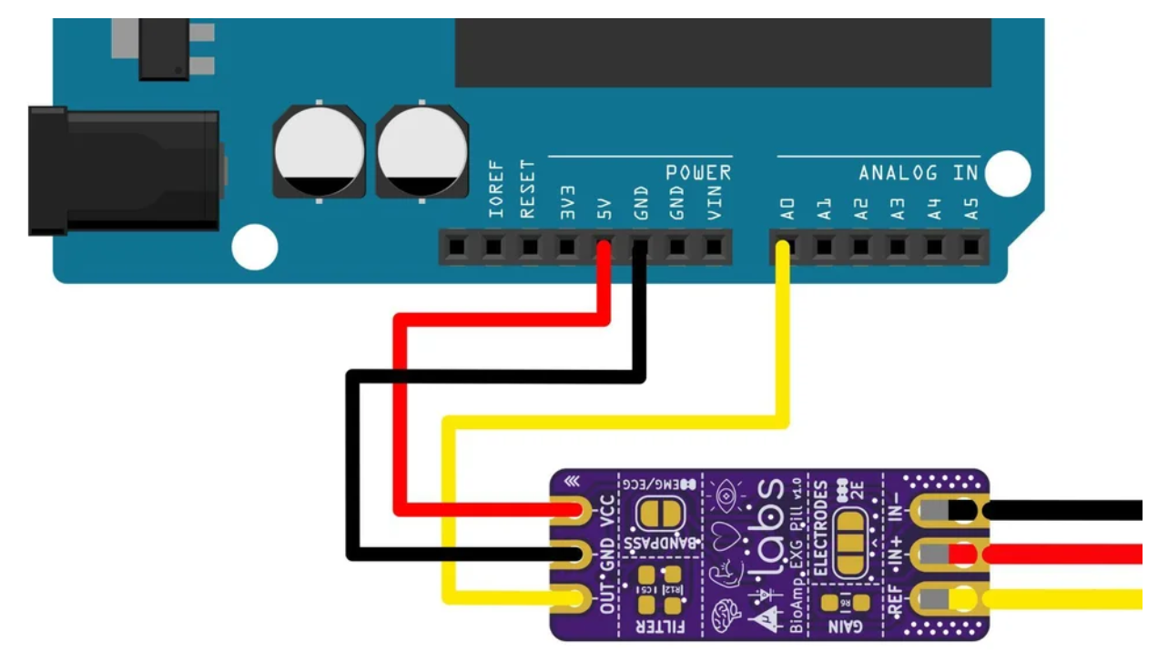
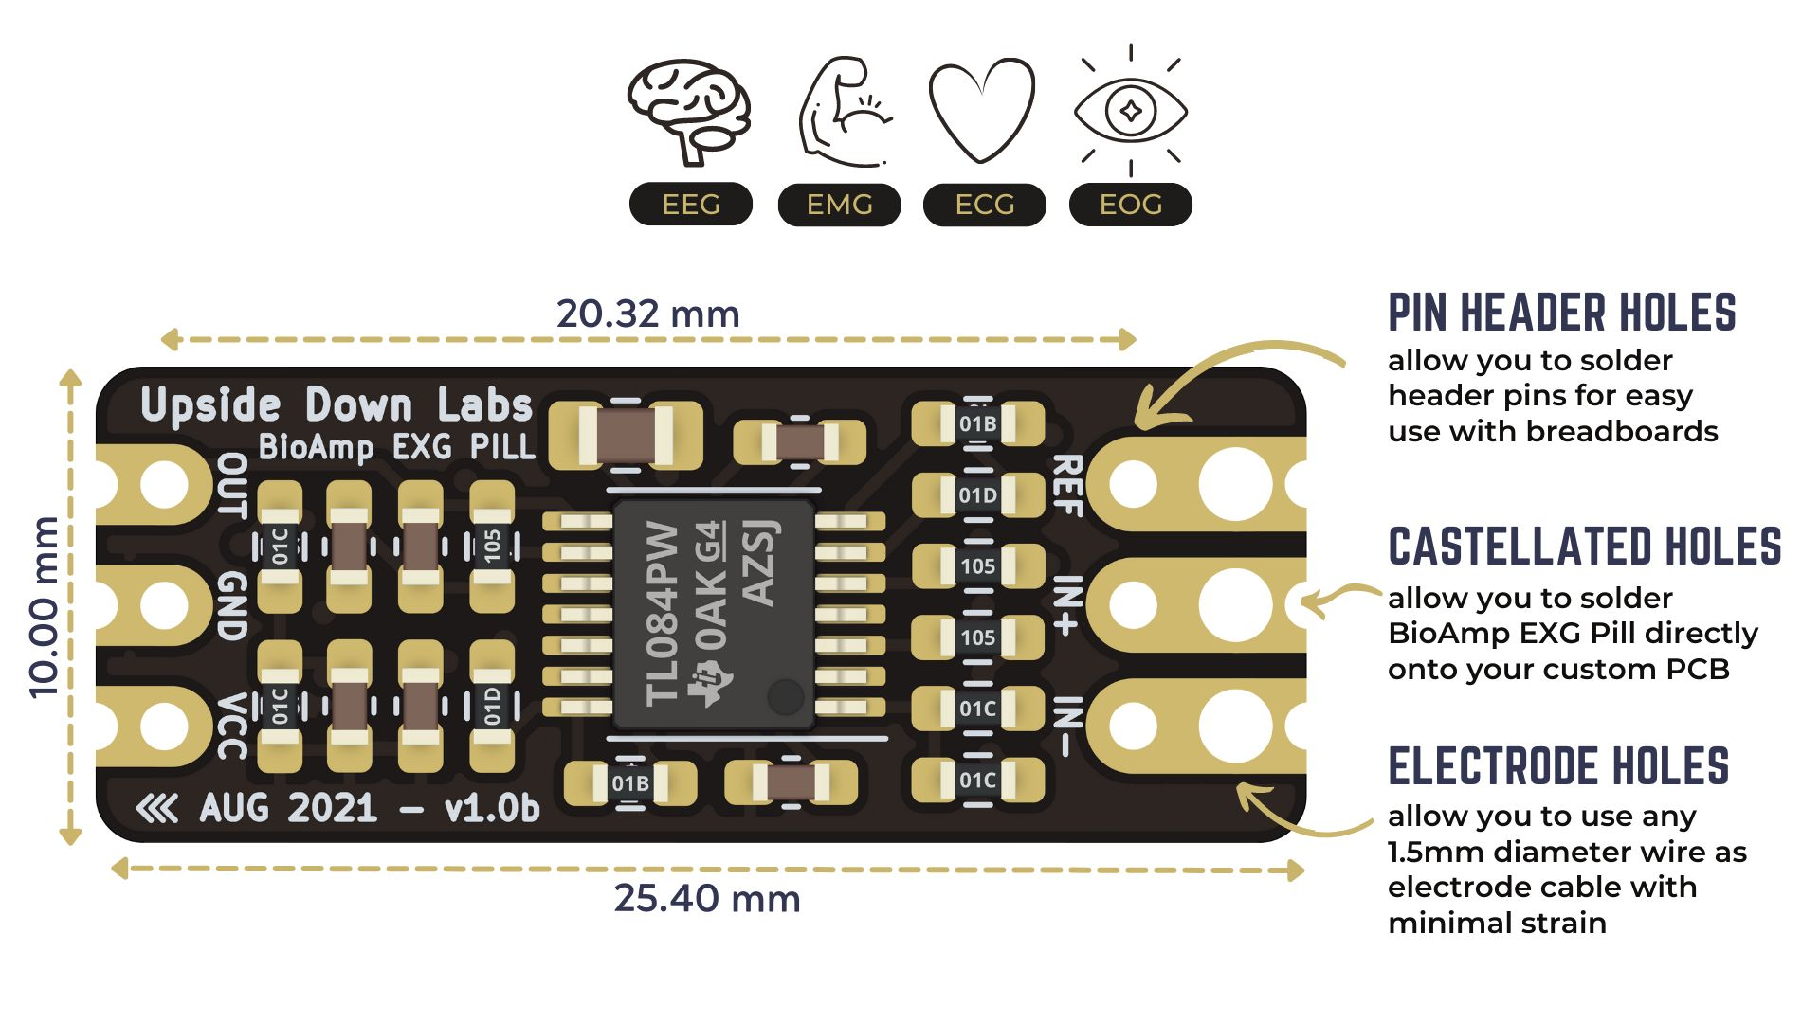
SCHEMATIC:
Connect BioAmp EXG Pill to Arduino Uno using the jumper cables as directed below:
VCC to 5V
GND to GND
OUT to A0

Slide 16
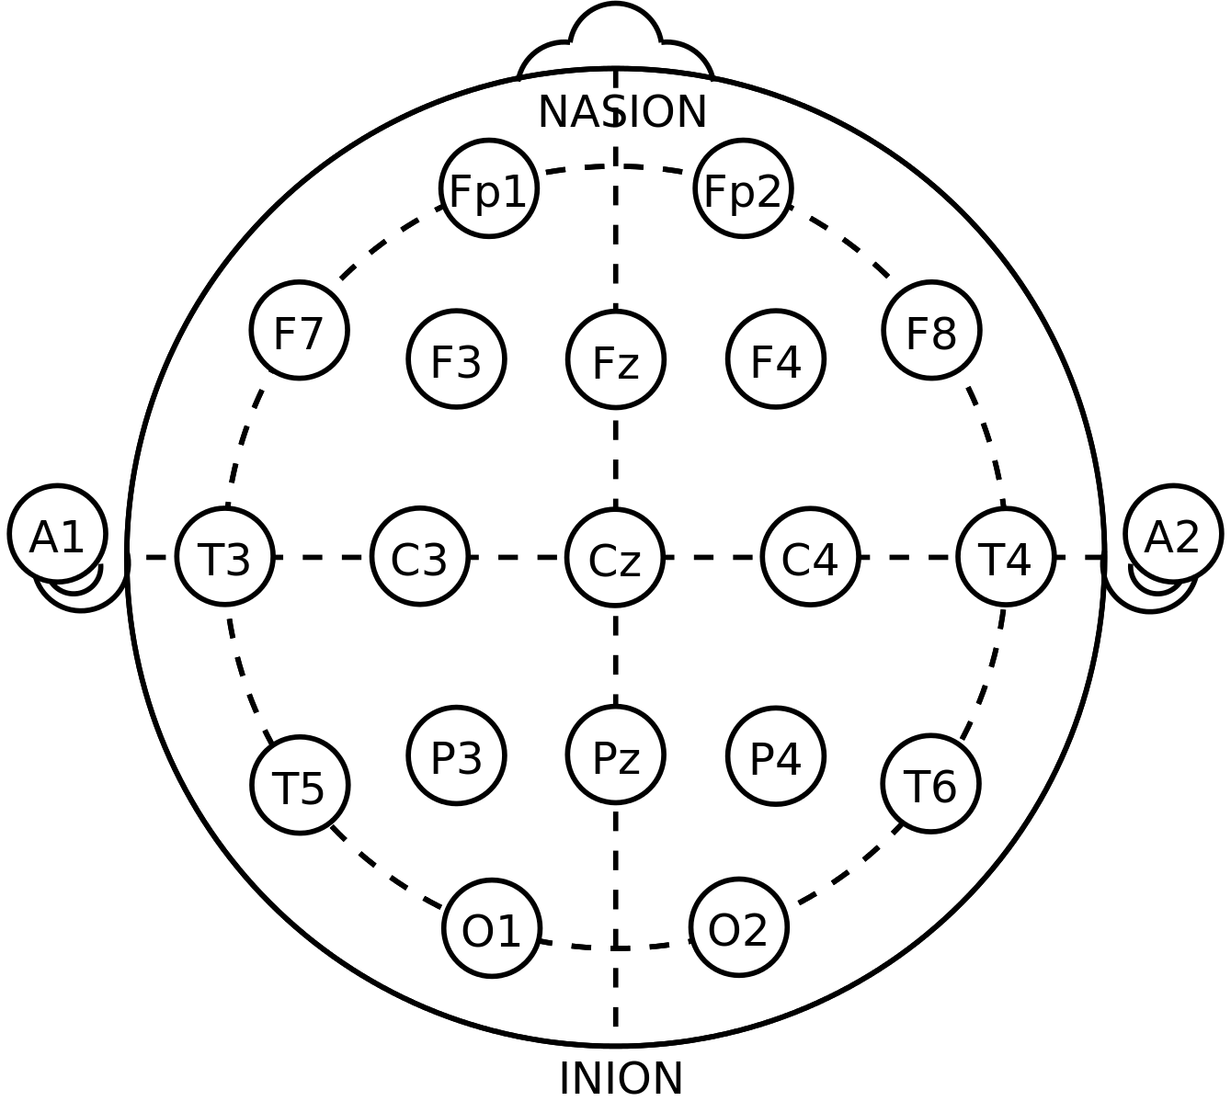
ELECTRODE PLACEMENT & SETUP
Skin preparation and apply conductive gel.
Connect the BioAmp cable to the gel electrodes.
Peel off the plastic backing from each electrode.
Place the electrodes as follows(As per 10-20 system):
IN+ (positive/input) → on the forehead at Fp1/Fp2
IN− (negative/ground) → also on the forehead, slightly apart from IN+
REF (reference) → on the bony area behind the ear, typically on the mastoid or earlobe (A1 or A2 position)

Slide 17

SIGNAL ACQUISITION :
Subjects: 5 individuals
States Recorded: Relaxed and Stress
Recording Protocol:
Total Samples:
5 subjects × 2 states × 3 trials = 30 recordings
For Relaxed State:
Subject asked to close eyes and remain calm with minimal body movements
3 EEG recordings of 30 seconds each were taken
For Stress State:
Mild pinch applied to induce stress
Subject kept eyes closed and minimal movement
3 EEG recordings of 30 seconds each were taken

Slide 18
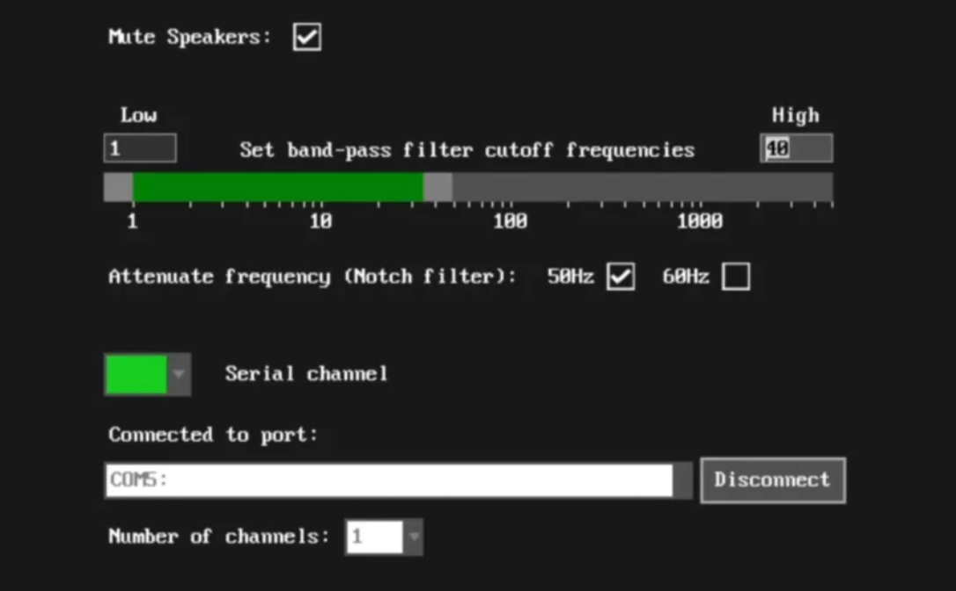
Spike Recorder: Acquires raw EEG data via Arduino’s serial port in .wav format.
Preprocessing Steps within Spike Recorder:
1. Bandpass Filter: 5–50 Hz (removes DC drift & high-frequency noise).
2. Notch Filter: 50/60 Hz (eliminates powerline interference).
Configurations on Spike Recorder

Slide 19
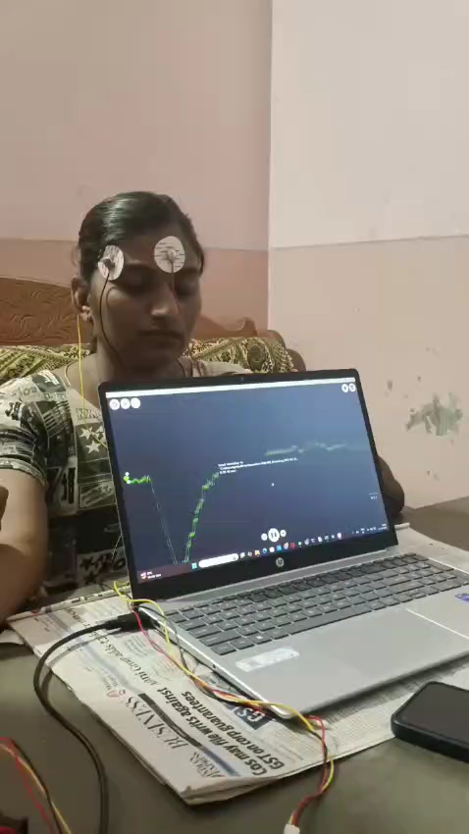
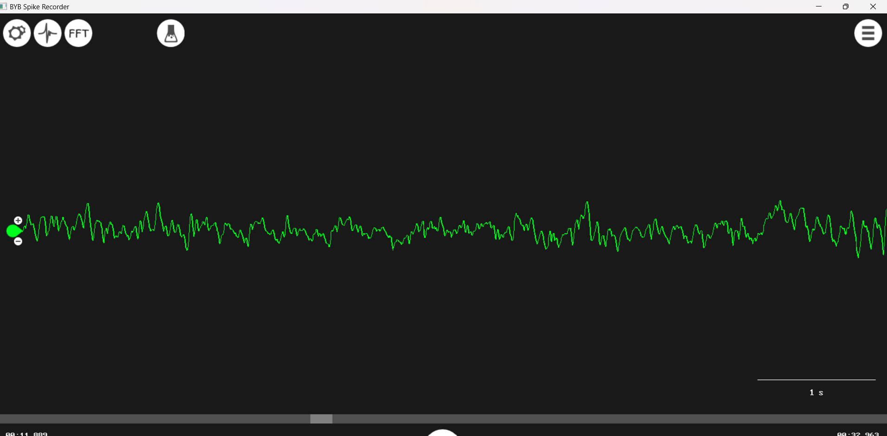
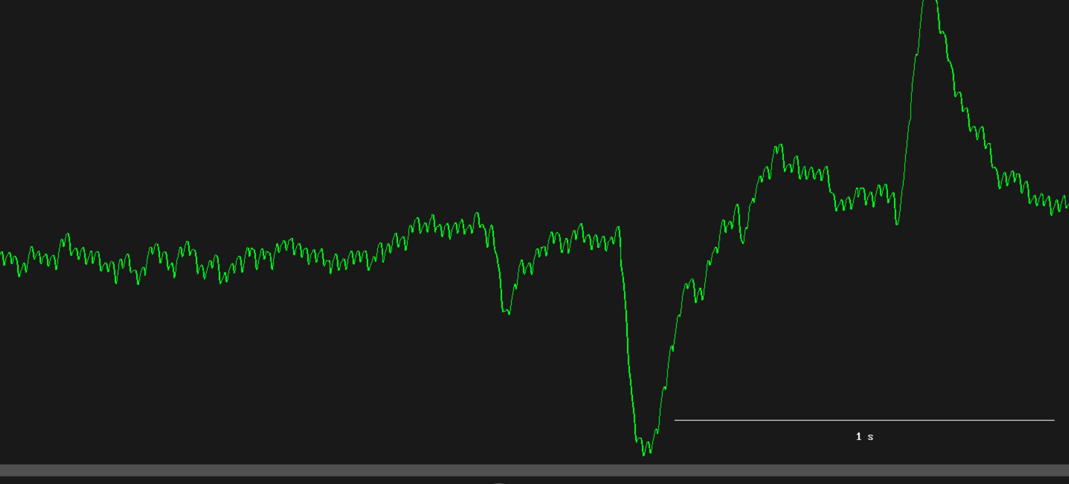
Relaxed State:
Stressed state:
Video

Slide 20
DATA PREPROCESSING:
wav files converted to .csv format
Segmentation done on each CSV (e.g., using fixed-length time windows)
Emotion labels assigned to each segment (as stress or relax)
Ready for feature extraction
FEATURE EXTRACTION:
Extracted Features:
Statistical: Mean, Standard Deviation, Skewness, Kurtosis
Temporal: Zero Crossing Rate (ZCR), Entropy
Frequency Domain: Alpha Power, Beta Power, Alpha-Beta Power Ratio

Slide 21
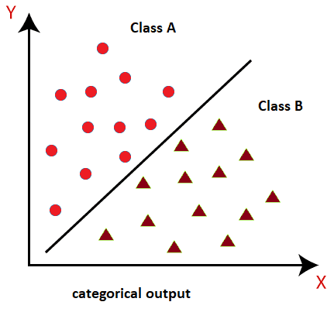
MODEL TRAINING AND EVALUATION
Trained Models:
SVM
KNN
Naive Bayes
Decision Tree
Features fed into classifiers to distinguish between stress/relaxed states
Evaluation metrics used: Accuracy, Precision, Recall, F1 Score
Random Forest
Logistic Regression
Linear Discriminate Algorithm
Perceptron

Slide 22
MODEL PERFORMANCE:
Model | Accuracy (%) | Precision (%) | Recall (%) | F1 Score (%)
Random Forest | 100.00 | 100.00 | 100.00 | 100.00
Decision Tree | 100.00 | 100.00 | 100.00 | 100.00
Perceptron | 98.18 | 98.44 | 98.44 | 98.44
KNN | 90.91 | 96.55 | 87.50 | 91.80
SVM | 90.00 | 93.44 | 89.06 | 91.20
Logistic Regression | 89.09 | 93.33 | 87.50 | 90.32
Naive Bayes | 83.64 | 96.00 | 75.00 | 84.21
LDA | 80.91 | 82.09 | 85.94 | 83.97

Slide 23
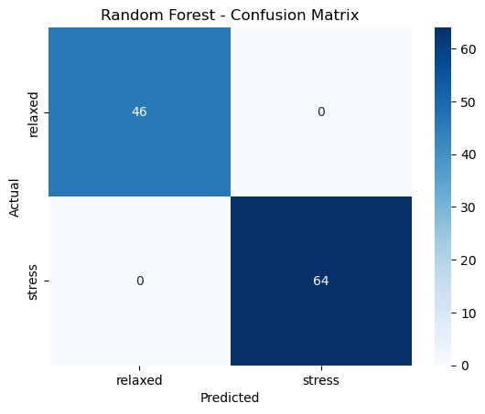
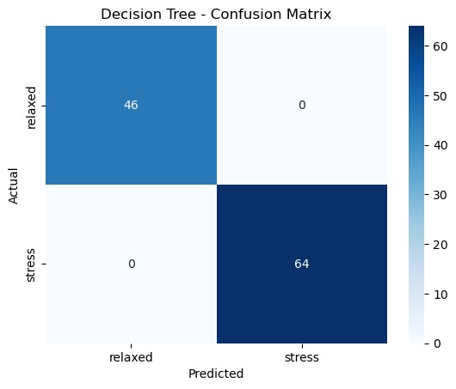

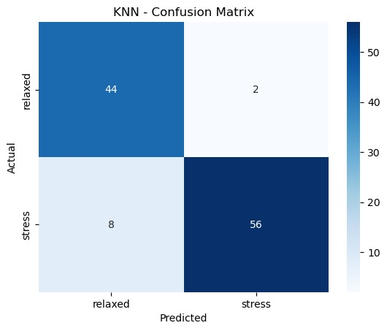

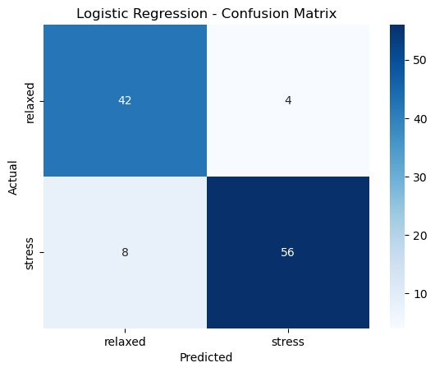
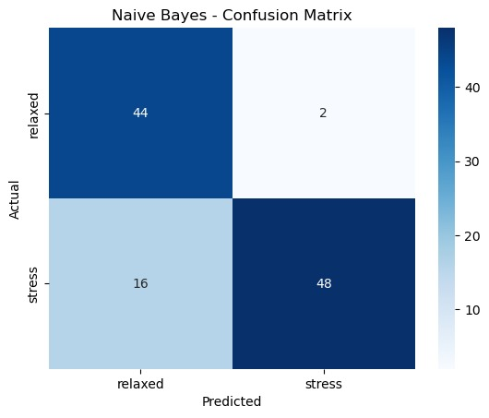
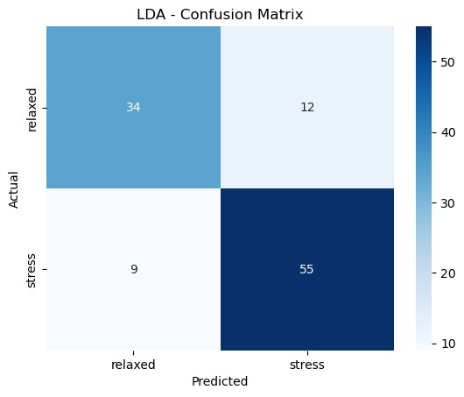
CONFUSION MATRIX:

Slide 24
CROSS-VALIDATION ACCURACY (MEAN ± STD):
Cross-validation was performed to assess generalization and avoid overfitting:
Model | CV Accuracy (%) ± Std
LDA | 98.00 ± 2.67
Logistic Regression | 97.33 ± 2.49
KNN | 97.33 ± 2.49
SVM | 96.67 ± 2.11
Random Forest | 96.00 ± 2.49
Decision Tree | 96.00 ± 3.27
Naive Bayes | 95.33 ± 2.67
Perceptron | 72.67 ± 6.46

Slide 25

RESULTS

Slide 26
RESULTS
Overall Model Evaluation
The performance of all classifiers was evaluated on:
Train/Test Accuracy (to check learning capacity and basic generalization)
Cross-Validation Mean ± Std (to assess stability across different data splits)
Overfitting Risk (based on performance gaps and complexity).
🔝 Best Performing Models (Balanced Performance)
LDA, Logistic Regression, KNN, SVM
These models showed:
High CV accuracy (96–98%)
Relatively balanced train-test accuracy
Low to moderate overfitting risk

Slide 27
Models Showing Overfitting
Random Forest and Decision Tree achieved perfect accuracy on both train and test sets, but had lower CV accuracy (96% and 95.33%), indicating overfitting on the training set.
These models may have memorized patterns instead of learning general features, especially due to the small dataset.
Underperforming Models
Perceptron had a lower test accuracy (80%) and high variance in CV (72.67% ± 6.46%), indicating instability and poor generalization.
Likely suffered from underfitting, possibly due to insufficient model complexity or poor data scaling.

Slide 28
Most Reliable Classifiers
LDA:
Despite moderate train accuracy (75.81%), LDA reached 100% test accuracy and the highest CV performance (98.00 ± 2.67).
It suggests LDA was less prone to overfitting, made robust generalizations, and was well-aligned with the data distribution.
SVM:
SVM achieved high train (89.52%) and perfect test accuracy (100%), along with a strong cross-validation score (96.67 ± 2.11), indicating reliable performance and good generalization.
It balances accuracy and stability well, making it a strong alternative for deployment when interpretability is less critical.

Slide 29

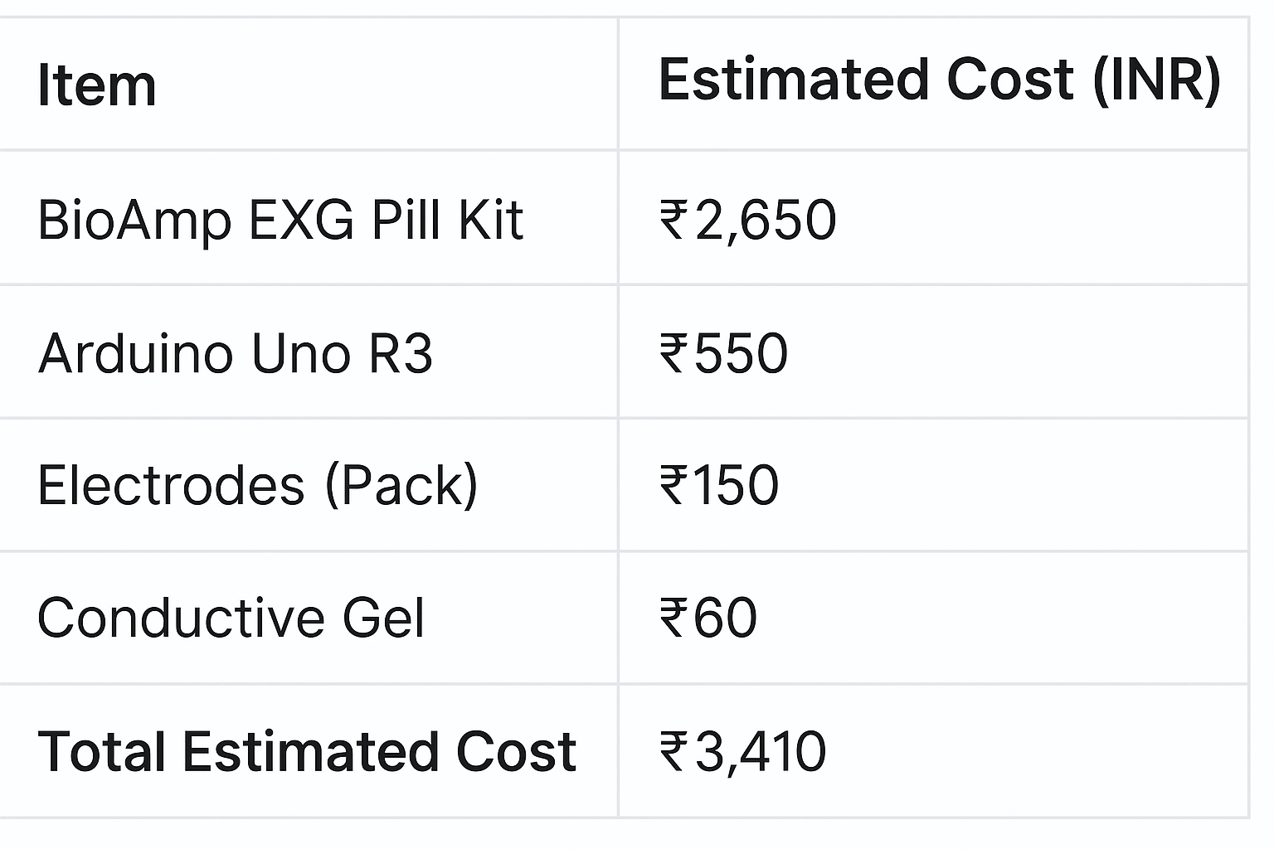
Cost analysis

Slide 30
FUTURE SCOPE
Real-Time Detection Implement live stress/relaxation monitoring using continuous EEG data.
Multi-Emotion Classification Extend to detect more emotions like calm, anxious, or focused.
Larger Dataset Training Improve model accuracy by collecting data from more participants.

Slide 31
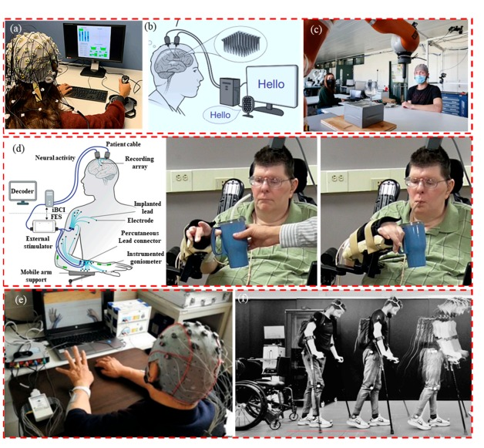
SOCIAL RELEVANCE
🔹 Mental Health & Well-Being - Helps in detecting stress, anxiety, and emotional states. - Supports early diagnosis and mental health monitoring.
🔹 Education & Workplace Applications - Enhances adaptive learning based on emotional states. - Improves productivity by monitoring stress and focus.
🔹 Human-Computer Interaction (HCI) - Enables emotion-based AI systems for personalized user experiences. - Supports research in neurofeedback and cognitive studies.
🔹 Assistive Technology for Disabilities - Can contribute to Brain-Computer Interface (BCI) applications. - Helps individuals with disabilities communicate and interact.
🔹 Rehabilitation & Healthcare - EEG-based monitoring aids stroke recovery and motor rehabilitation. - Supports patients with spinal cord injuries through neurofeedback.
🔹 Future Potential - Expands into smart wearables, mental health apps, and BCI-controlled devices. - Provides affordable emotion monitoring for diverse applications.

Slide 32
References:
Jalilifard, A., et al. (2016). Classification of human emotions from EEG signals using SVM and LDA Classifiers. Academia.edu. https://www.academia.edu/25962576
Gómez, A., Quintero, L., López, N., et al. (2017). An approach to Emotion Recognition in Single-channel EEG Signals using Stationary Wavelet Transform. In CLAIB 2016, IFMBE Proc., vol. 60, Springer. https://doi.org/10.1007/978-981-10-4086-3_39
Morsalin, S. M. S. (2020). Front-End Circuit Design for EEG Signal. Master’s Thesis, Nanhua University.
Mamee, T., Manorost, P., Chamroon, C., & Thunsiri, K. (2023). Comparative Analysis of AD8232 and BioAmp EXG Pill Analog Front-End Devices in ECG Signal Processing. In 2023 ICSSIP. https://ieeexplore.ieee.org/document/10351452
Saptono, D., Wahyudi, B., & Irawan, B. (2016). Design of EEG Signal Acquisition System Using Arduino MEGA1280 and EEGAnalyzer. MATEC Web Conf., 75, 04003. https://doi.org/10.1051/matecconf/20167504003
BioAmp EXG Pill (2022). Recording EEG from Visual Cortex Using BioAmp. Instructables. https://www.instructables.com/Recording-EEG-From-Visual-Cortex-Using-BioAmp-EXG-/
Li, X., Song, D., Zhang, P., & Hou, Y. (2022). EEG-Based Emotion Recognition: A Tutorial and Review. arXiv:2203.11279. https://arxiv.org/abs/2203.11279
Yutian, T., et al. (2024). Design and Implementation of an Emotion Analysis System Based on EEG Signals. arXiv:2405.16121. https://arxiv.org/abs/2405.16121

Slide 33

Thank You

